Slide 1

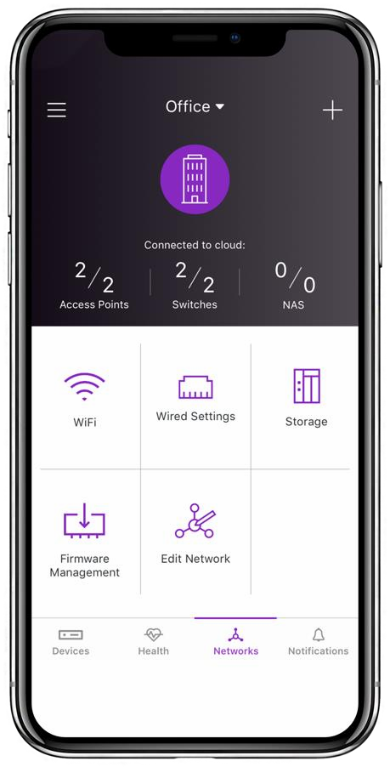



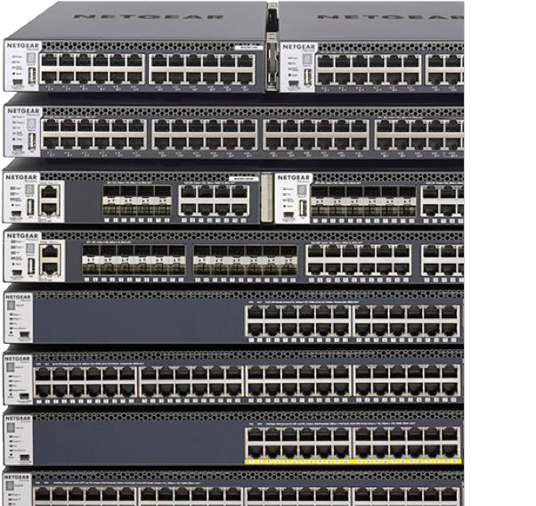
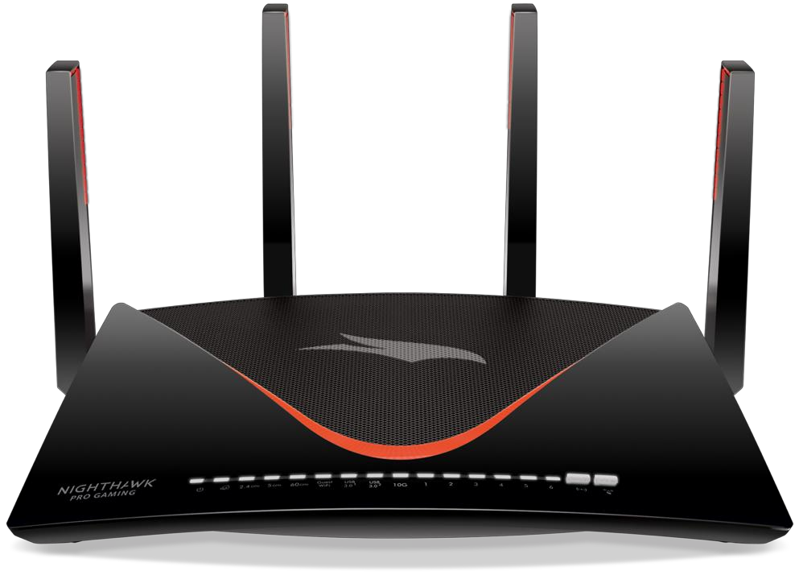
Cost of Complexity - CHP
Mid-point Presentation, January 18, 2019

Slide 2
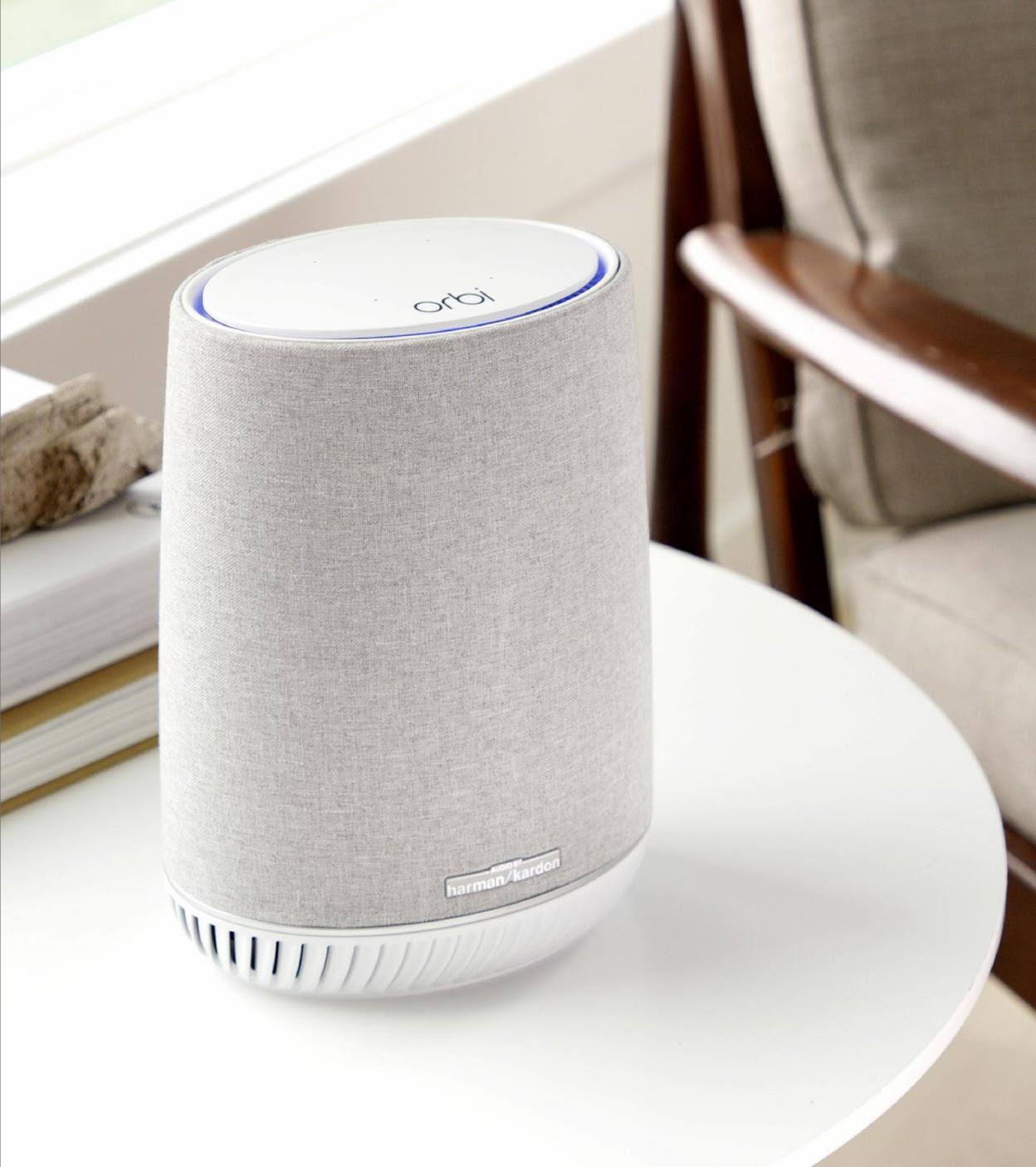
Agenda
Team Introduction
Executive Summary
SKUs selected for analysis
Pareto 80/20 analysis
Obvious cut-offs for profits
Trends
Demo
Perceptual Maps/Competitive Analysis
Summary
Q&A

Slide 3




Masters in Financial Management/
Bachelors in International Economics and Trade
Annie has 3+ years of experience in financial management and has worked with top-tier venture capital firm to connect the best technology startups with the world’s largest corporations for cross-border businesses.
Photography
Guzheng
Annie Song
MBA
Notes:
I moved more than 10 times and 5 cities over the past 10 years. Her expertise includes financial planning and analysis, accounting, valuation, business model, and industry analysis.

Slide 4










Masters in Aerospace/
Bachelors in Aerospace
GE Aviation |5+ years | Senior Application Engineer | Agile Scrum Master
Trekking
Minsuk
Gregy Thomas
MS in Business Analytics
Notes:
Data Scientist leader whose functionality crosses over between product management and machine learning.

Slide 5





B.S. in Business Administration Finance at UNC Pembroke
China Resources - Fortune Global 500;
Created KPI dashboards to track weekly performance of QDII cooperation projects between CR Trust and Morgan Stanley,
Travelling
Volunteering in Aiesec Cambodia
Minsuk
Mingyu Liao
MS in Business Analytics
Notes:
A passionate “data story teller”! I use data and technology to empower people and provide innovative solutions to employers

Slide 6







Masters in Mathematics/
Bachelors in Electrical Engineering
Product Manager for e-commerce websites
Software developer : Developing network monitoring devices
Travelling and Dancing
Minsuk
Manasa Nelakuditi
MBA
Notes:
Manasa has 4 years software development and product management in e-commerce and financial services

Slide 7
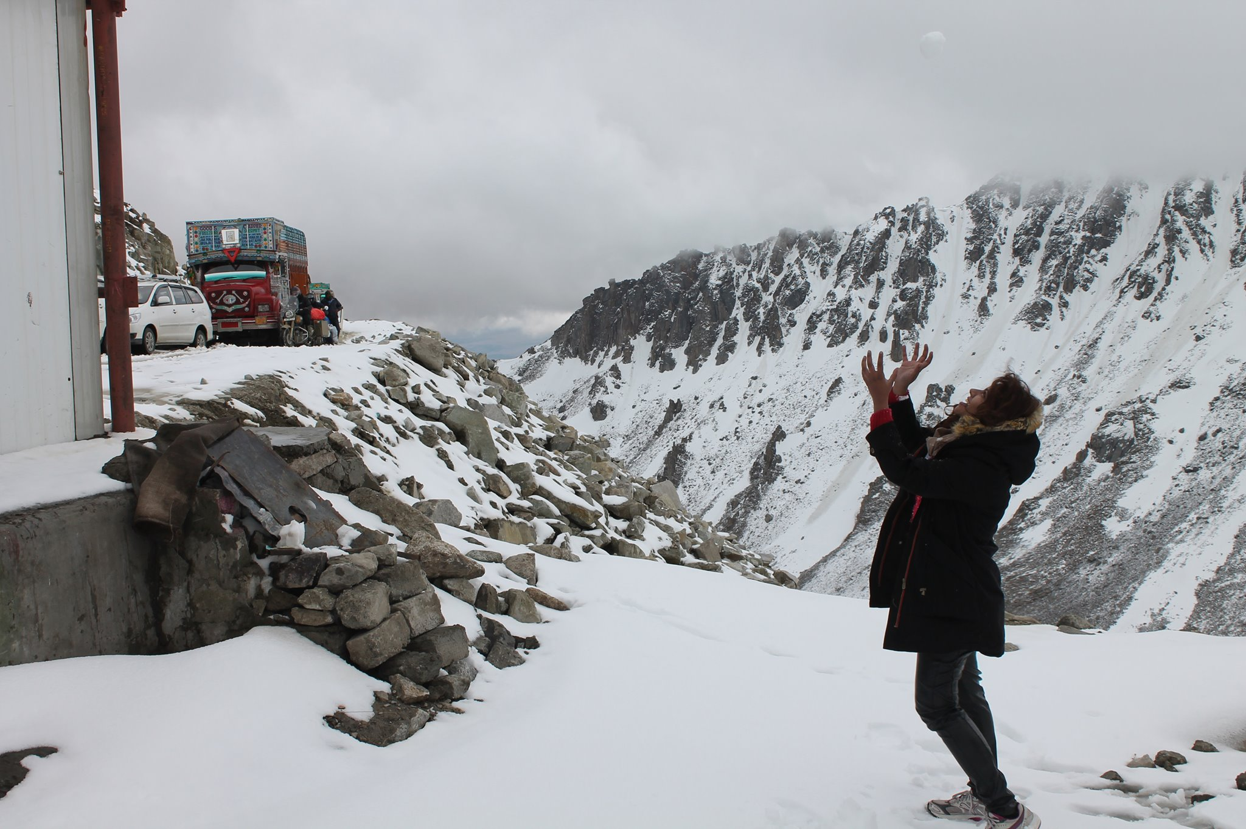







Bachelors in Civil Engineering
Product Manager, Growth Marketer for SaaS, entertainment-tech and food-tech startups
Hiking, Music, Painting
Swapna Kutcharlapati
MBA Class of 2020
Notes:
Swapna has over six years of experience in product leadership roles, with a focus on product marketing, growth strategy, and product management.

Slide 8
Executive Summary
1
Built a model to list the products generating bottom 20% of profits.
2
Price elasticity and Cross Price elasticity across Product lines.
3
Conducted competitive analysis and created perceptual maps.

Slide 9
SKUs selected for Analysis
Years 2017(Q1-Q4) - 2018(Q1-Q3)
Only included products sold in both 2017 and 2018
Excluded all EOLs based on the data provided to us
Products: Cable, Range extender, Routers and WIFI-Systems
Intra cross elasticity includes the item SKUs belongs to that product line only
Excluded products that have small negative quantities and/or revenues

Slide 10
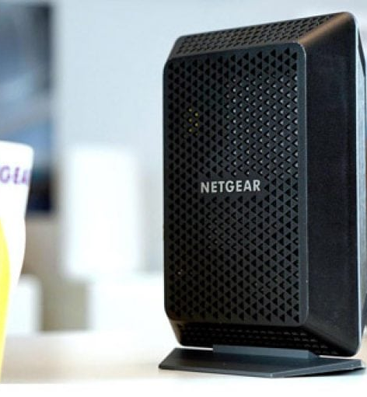
Pareto
Sales Margin
Standard Cost
Sales Thru Qty
Sales Thru Dollars

Slide 11
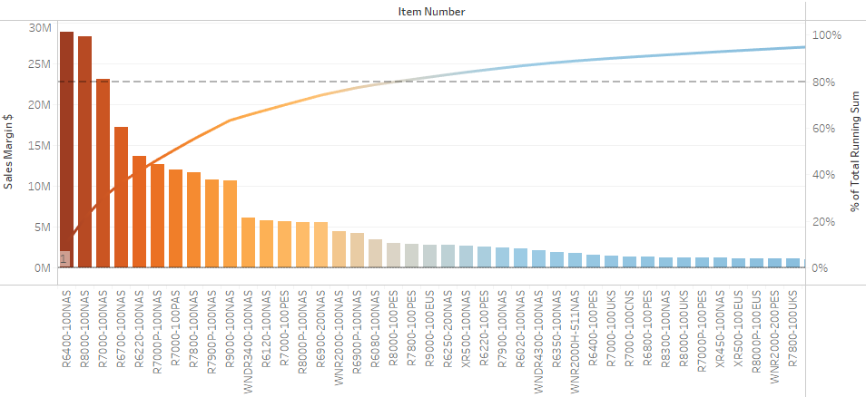
Routers Sales Margin

Slide 12
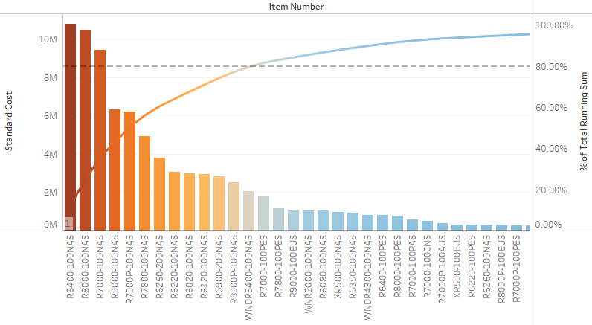
Routers Standard Cost

Slide 13
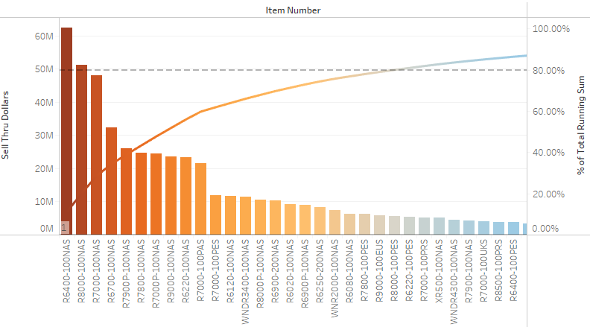
Routers Sell Thru Dollars

Slide 14
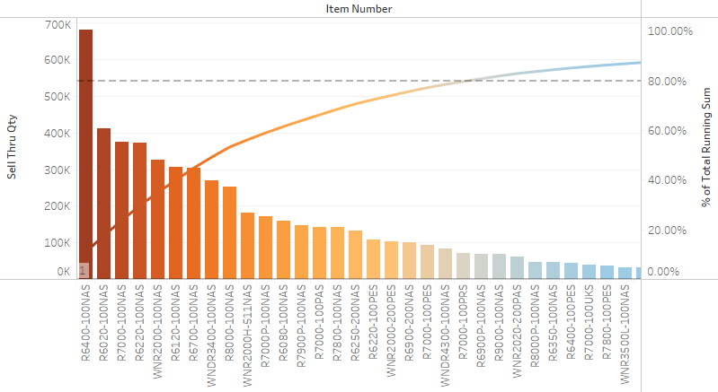
Routers Sell Thru Qty

Slide 15
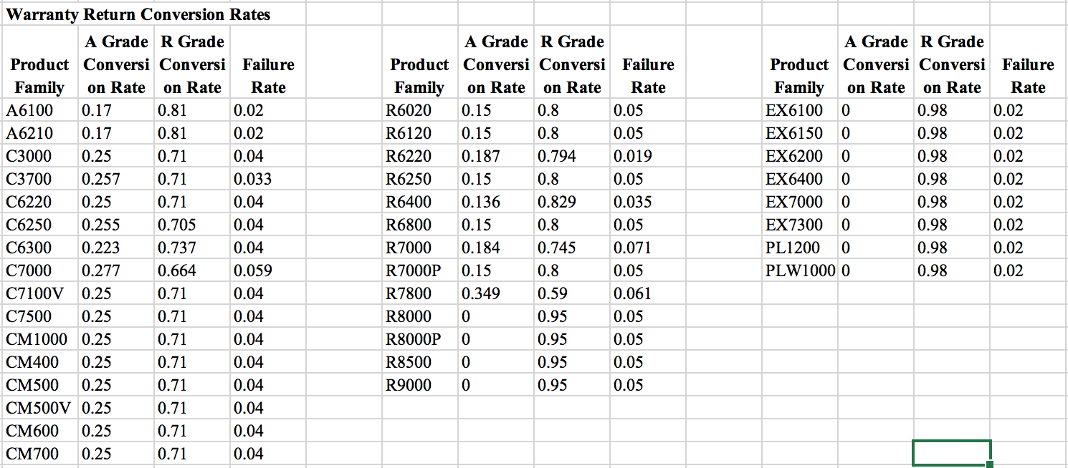
Return Conversion Rates & Marketing Cost
Notes:
We get the net profit after considering the failure rate and marketing cost. For Marketing cost, we allocate the quarterly cost to each product according to their share of revenue to the total revenue of allproducts. For warranty cost, we adjust the profit by the failure rate.

Slide 16
Trend Analysis
Revenue
Revenue Ranking
Net Profit
Net Profit Percentile

Slide 17
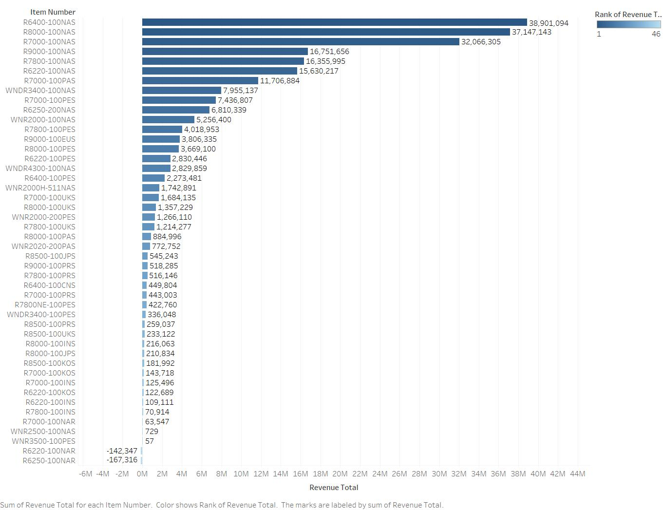
Router Item-wise Revenue Distribution
Bottom 20%
R7000-100KOS
R7000-100INS
R6220-100KOS
R6220-100INS
R7800-100INS
R7000-100NAR
WNR2500-100NAS
WNR3500-100PES
R6220-100NAR
R6250-100NAR

Slide 18
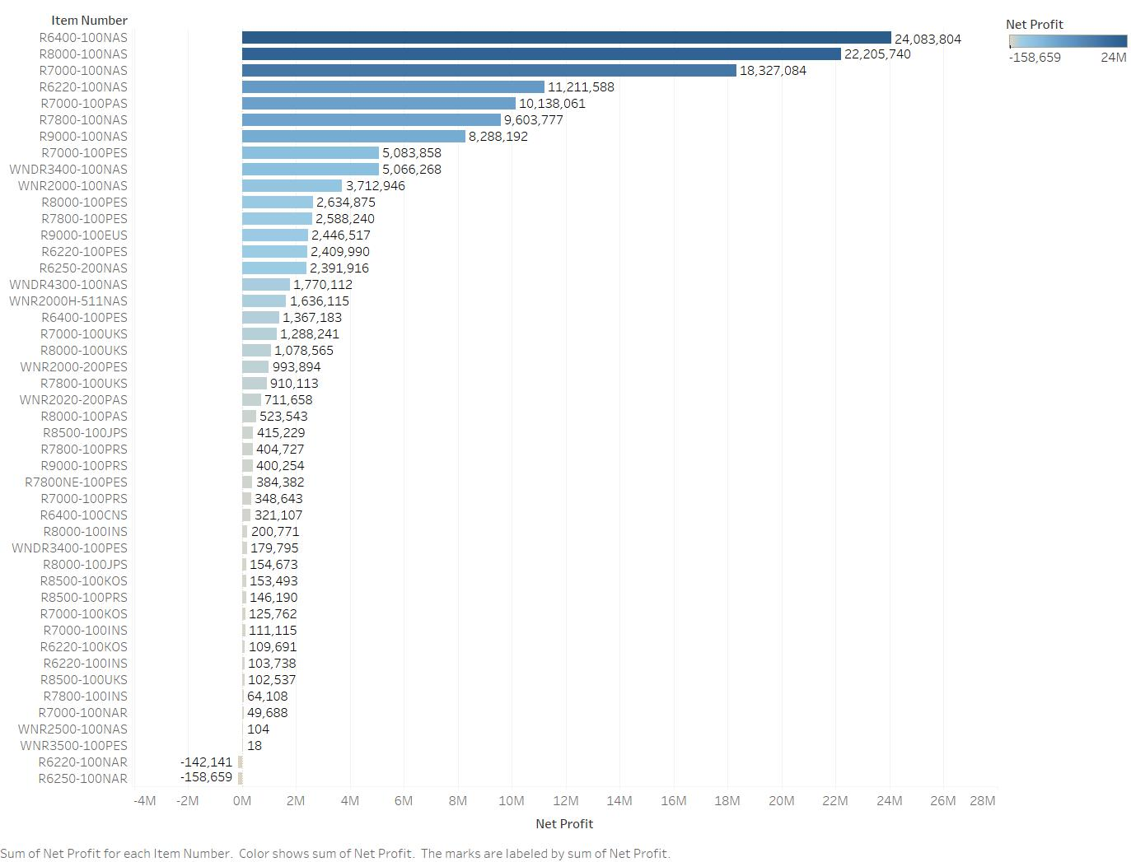
Router Item-wise Net Profit Distribution
Bottom 20%
R7000-100INS
R7000-100KOS
R6220-100INS
R8500-100UKS
R7800-100INS
R7000-100NAR
WNR2500-100NAS
WNR3500-100PES
R6220-100NAR
R6250-100NAR

Slide 19
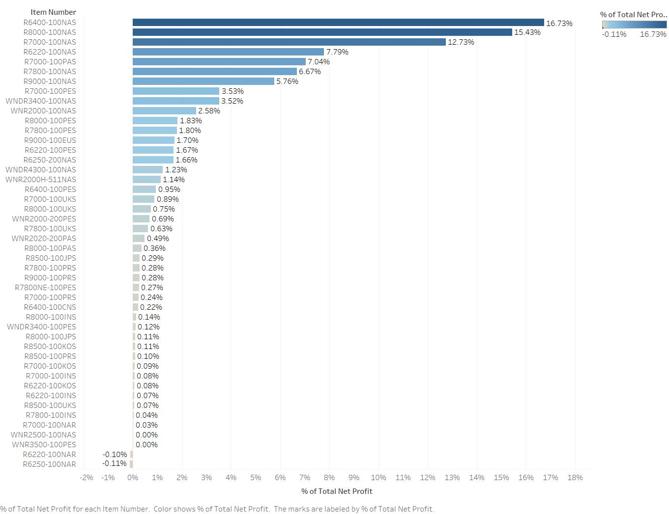
Router Item-wise Net Profit Percentile Distribution
Bottom 20%
R7000-100INS
R7000-100KOS
R6220-100INS
R8500-100UKS
R7800-100INS
R7000-100NAR
WNR2500-100NAS
WNR3500-100PES
R6220-100NAR
R6250-100NAR

Slide 20
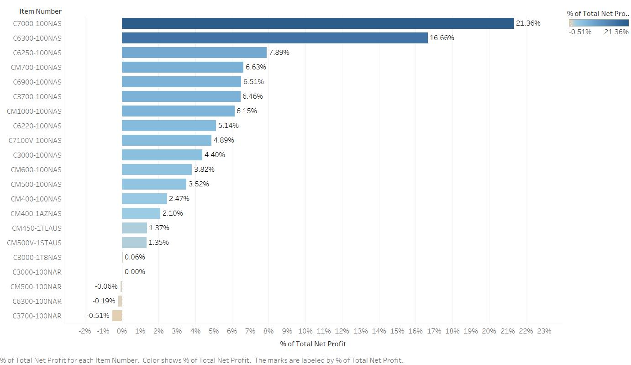
Cable Item-wise Net Profit Percentile Distribution
Bottom 20%
C3000-1T8NAS
C3000-100NAR
CM500-100NAR
C6300-100NAR
C3700-100NAR

Slide 21
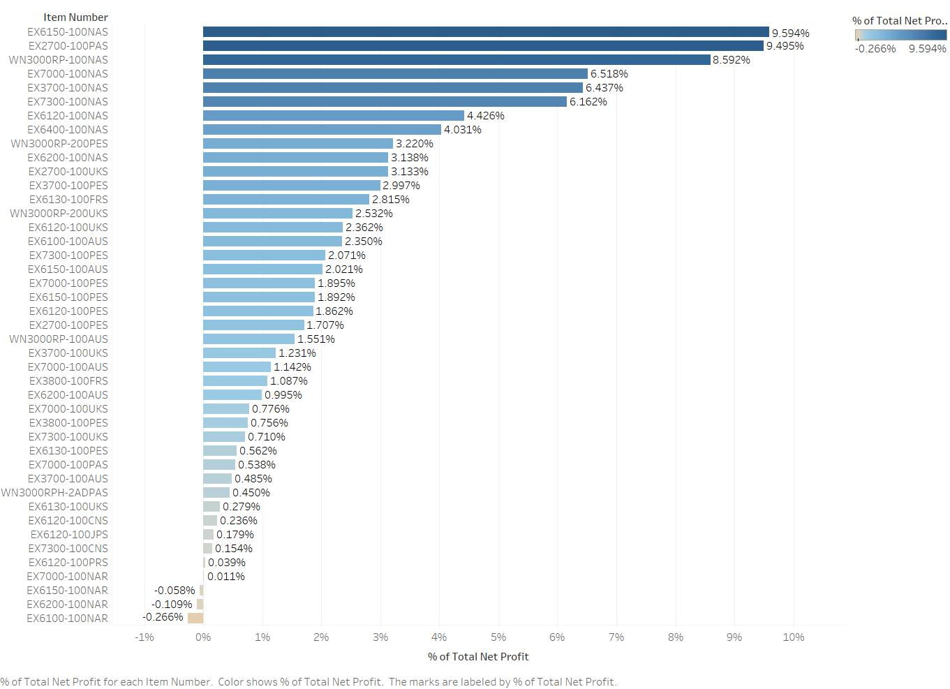
RangeEx Item-wise Net Profit Percentile Distribution
Bottom 20%
EX6130-100UKS
EX6120-100CNS
EX6120-100JPS
EX7300-100CNS
EX6120-100PRS
EX7000-100NAR
EX6150-100NAR
EX6200-100NAR
EX6100-100NAR

Slide 22
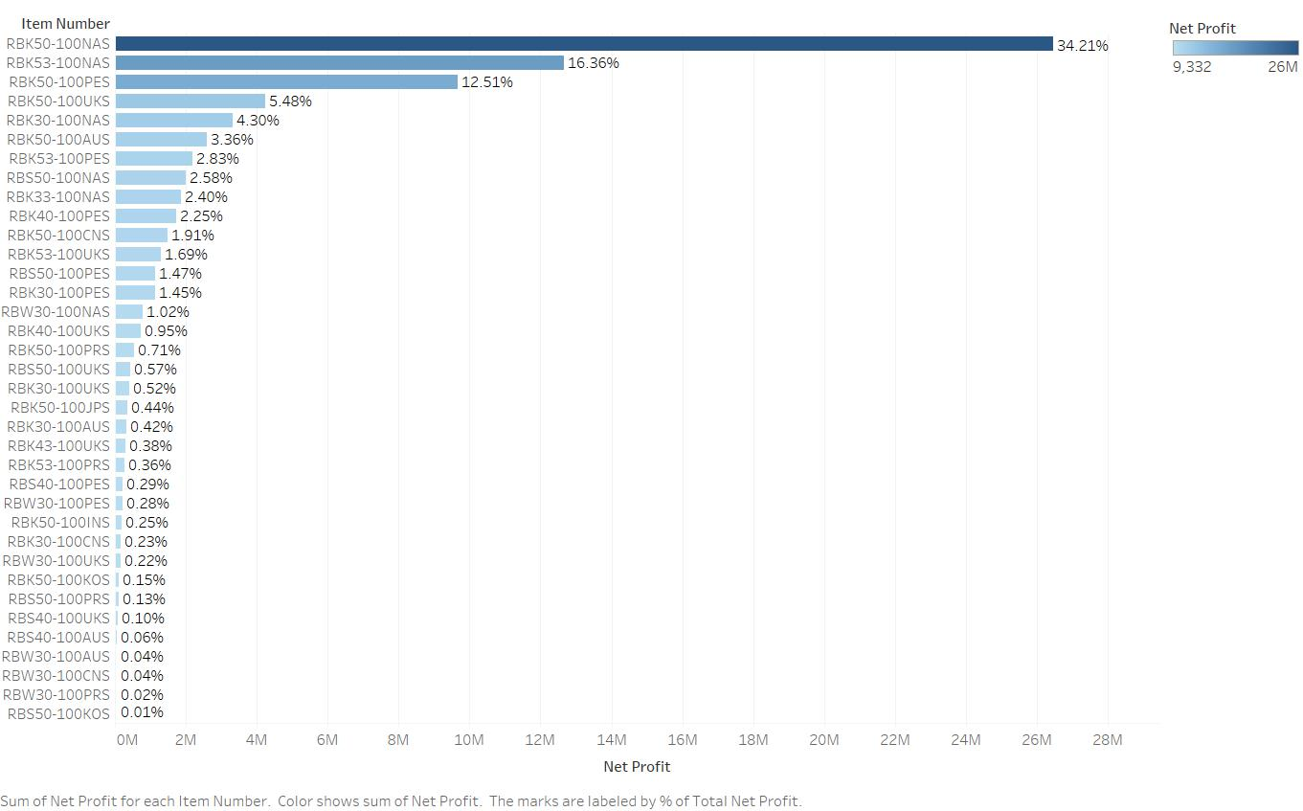
Wifi Item-wise Net Profit Percentile Distribution
Bottom 20%
RBK50-100KOS
RBS50-100PRS
RBS40-100UKS
RBS40-100AUS
RBW30-100AUS
RBW30-100CNS
RBW30-100PRS
RBS50-100KOS

Slide 23
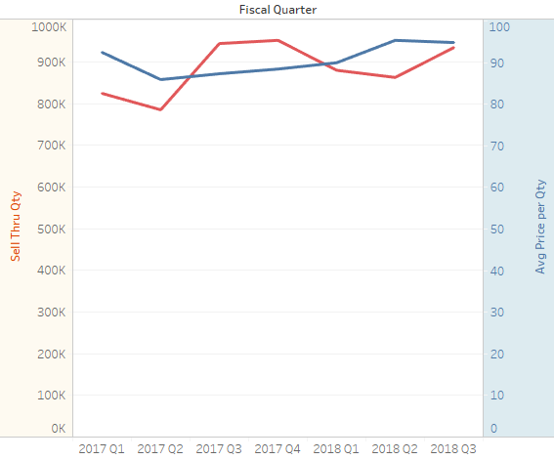
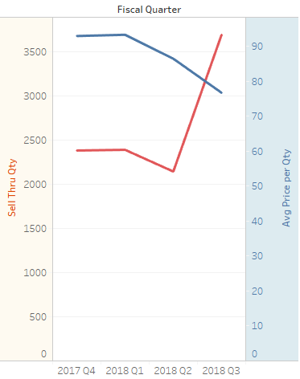
Price Elasticity – Routers
Router : All Items
Router Item: R6120-100AUS

Slide 24
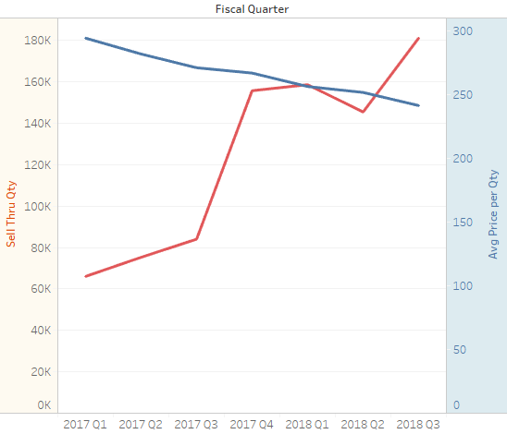
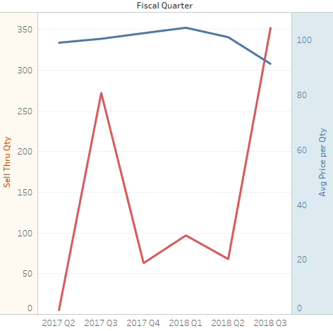
Price Elasticity – WiFi
WiFi: All Items
WiFi Item: RBW30-100AUS

Slide 25
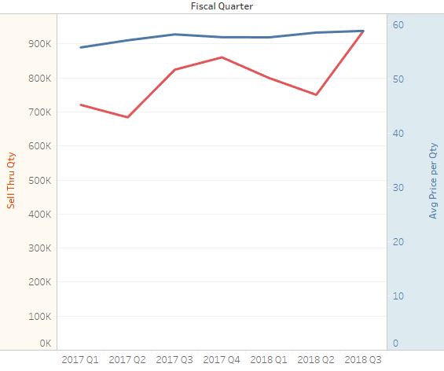
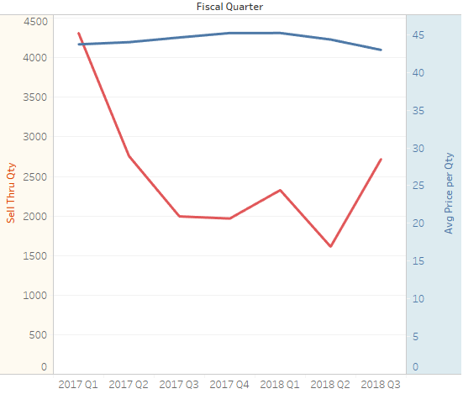
Price Elasticity – Range Extender
Range Ex: All Items
Range Ex Item: EX3700-100AUS

Slide 26
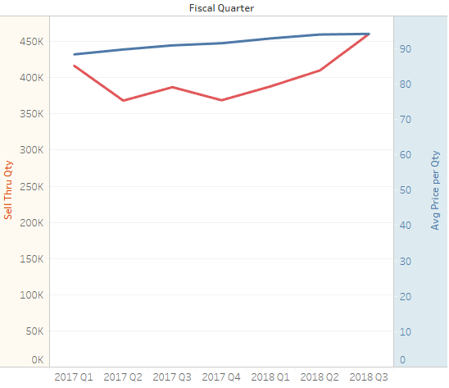
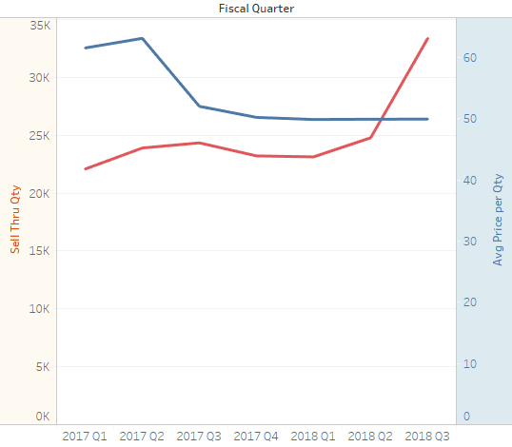
Price Elasticity – Cable
Cable : All Items
Cable Item: CM500-100NAS

Slide 27
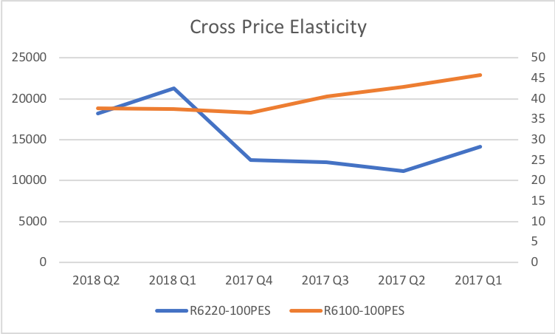
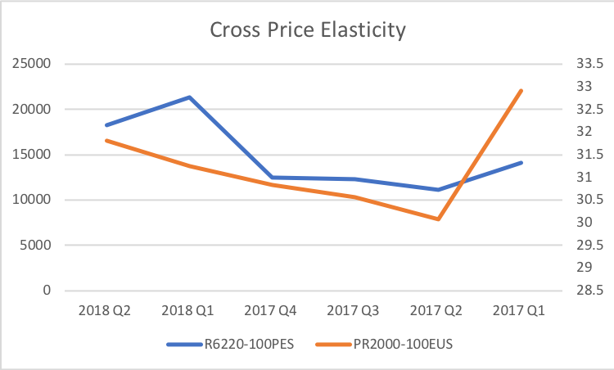
Cross Price Elasticity – Router(R6220-100PES)

Slide 28
Industry Trends
Threat of New Entrants
MEDIUM
Bargaining Power of Suppliers
MEDIUM
Rivalry
HIGH
Bargaining Power of Buyers
HIGH
Threat of Substitutes
LOW

Slide 29
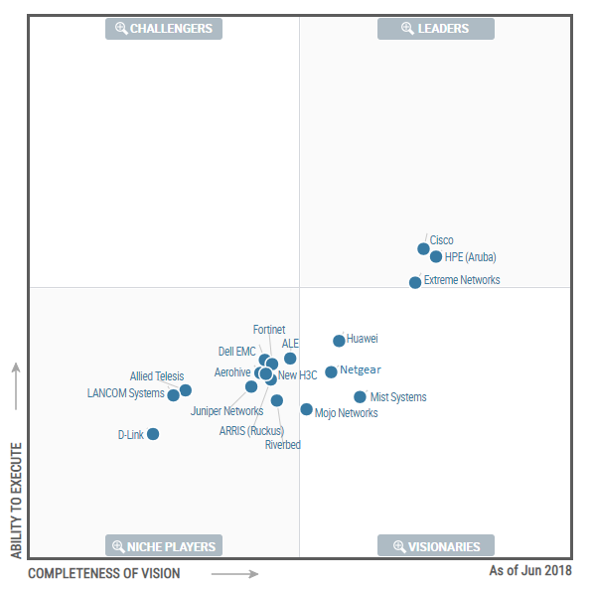
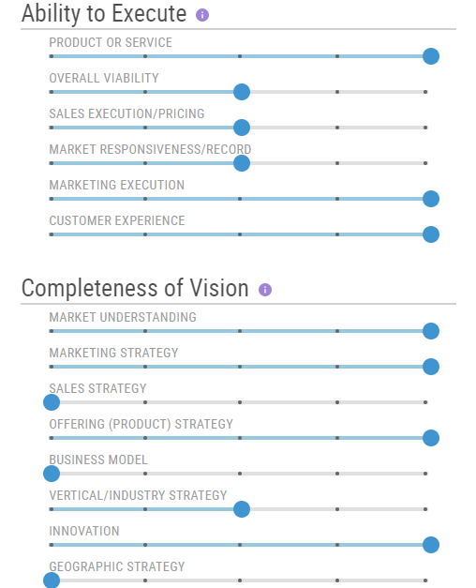
Wired and Wireless LAN Access Infrastructure
Source – Extrapolated based on Gartner Peer Reviews

Slide 30
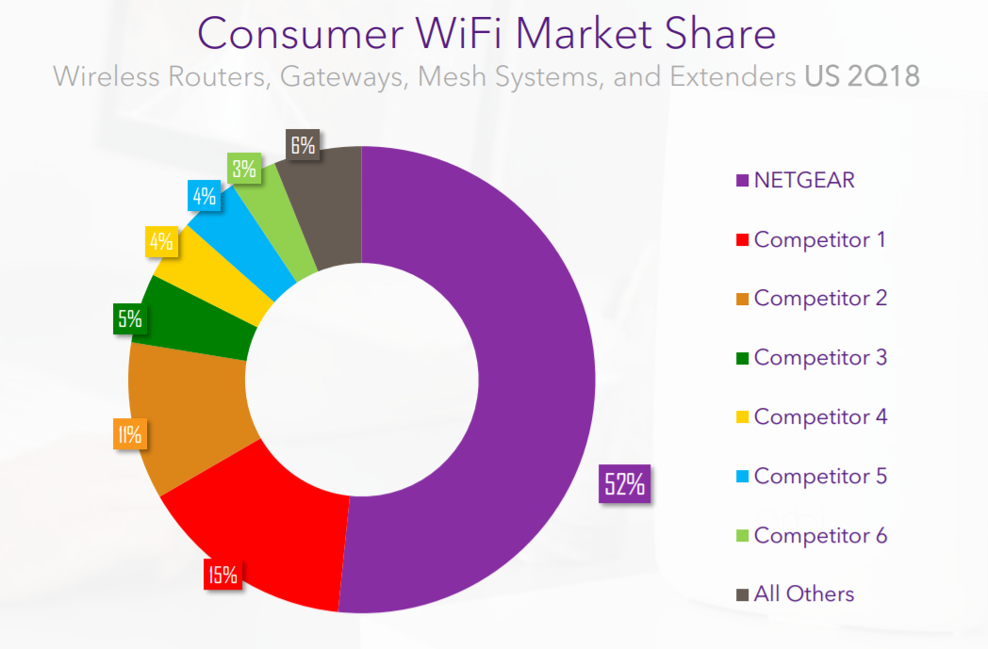
Market Share

Slide 31



















Competitors
Major Competitors
Limited Competitors

Slide 32
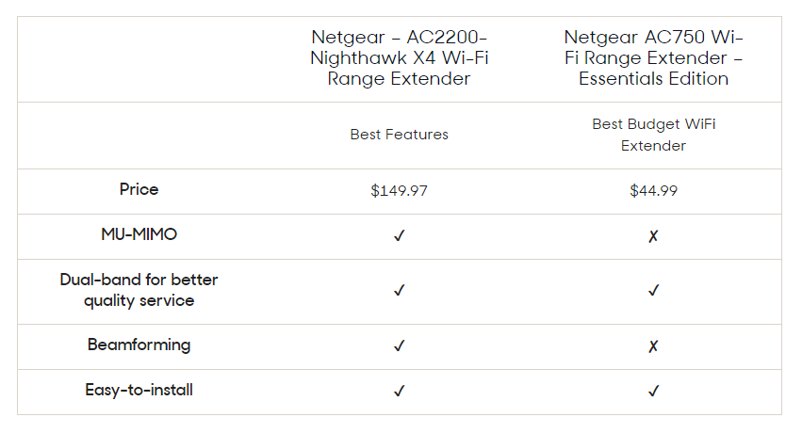
Customer Perception – Range Extenders
Source - https://www.reviews.com/best-wireless-router/

Slide 33
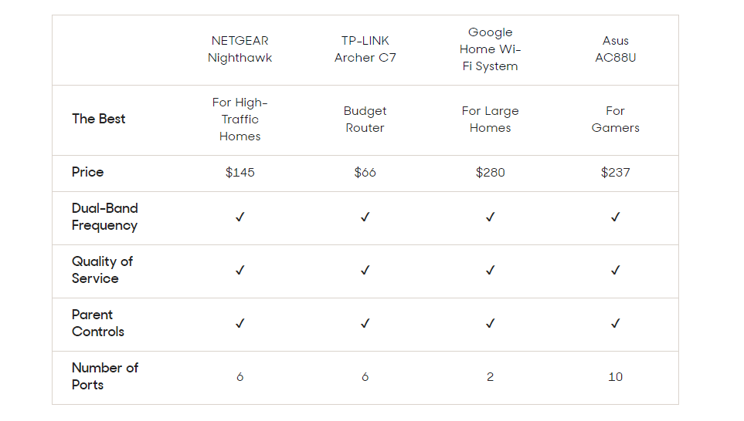
Customer Perception – Wireless Routers
Source - https://www.reviews.com/best-wireless-router/

Slide 34

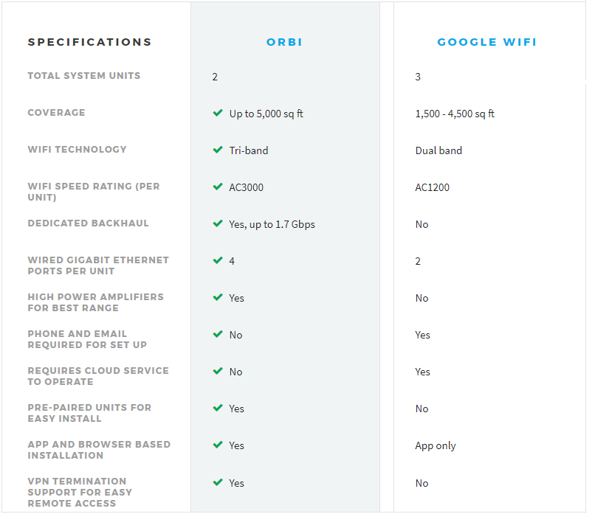
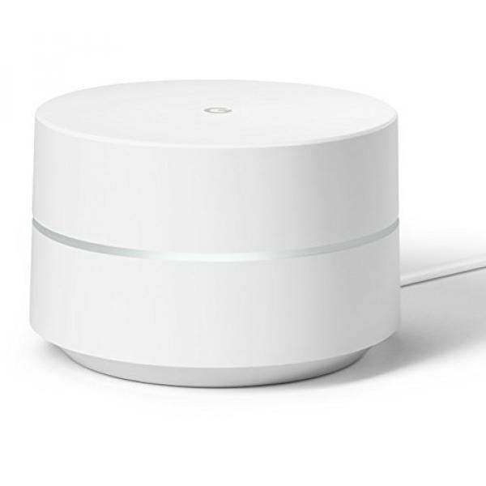
High-end Competition – Google Wi-Fi
+ MU-MIMO technology
+ Easy to install
+ Supports VPN
+ Compatible with Alexa
+ Includes Circle with Disney Smart Parental Controls
+ Can manage your WiFi from each device, mobile apps or via website
+ 1-year warranty
+ MU-MIMO technology + Easy to install
+ 24/7 tech support
+ Compatible with IFTTT + Allows you to pause WiFi on kids devices and block websites
+ Set up, manage WiFi, prioritize devices and more via mobile app
+ 1-year warranty
- Free tech support only for 90 days
- Must purchase modem separately
- Some users report unstable connections
- Lacks USB ports
- Can’t choose your band
- Must purchase modem separately
- Doesn’t support VPN

Slide 35
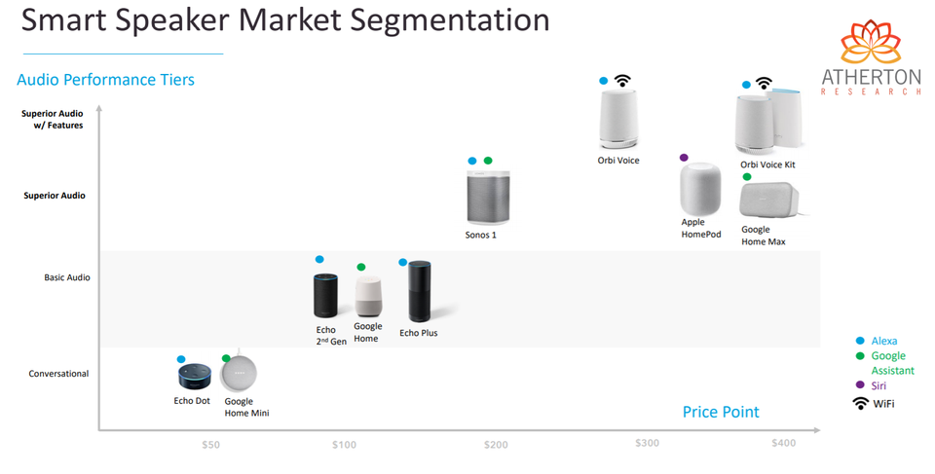
Smart Speaker Market Segmentation

Slide 36
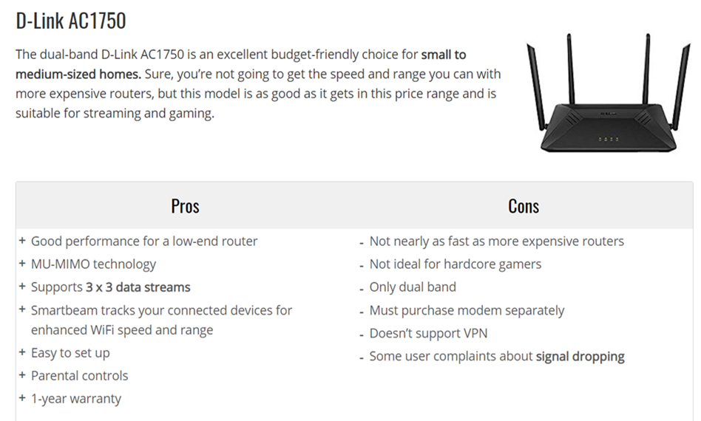
Budget Competition - Under $100

Slide 37
Routers – Bottom 20%
Profit Making?
No
Product | Our Price | Closest Competitor | Competitor's Price
R7000-100INS | (PAS)$149.99 | TP-Link AC1900 | $89.97
R7000-100KOS
R6220-100INS | $70
R8500-100UKS | 380 Euros
R7800-100INS | ₹14,499 | D-Link DIR-882 AC2600 MU-MIMO | ₹8,099
R7000-100 NAR | $109
WNR2500-100NAS | $42.98 | NETGEAR AC1000 R6080) | $51.93
WNR3500-100PES
R6220-100NAR | $69.95 | TP-Link AC900 Gigabit Router | $32.99
R6250-100NAR | $84.95
Yes
Helps Maintain Channel Contracts?
Yes
No
Risk of losing to competitors?
Yes
No
Lose It!
Keep it!

Slide 38

Next Steps
Evaluate decision tree results for the bottom 20% products across all four product lines.
Ensure cutting low profit products doesn’t have negative effects on existing CHP portfolio.
Develop pricing/ messaging recommendations for products that are positioned to pull market share from competitors

Slide 39
Thank you!
Cost of Complexity - CHP

Slide 40
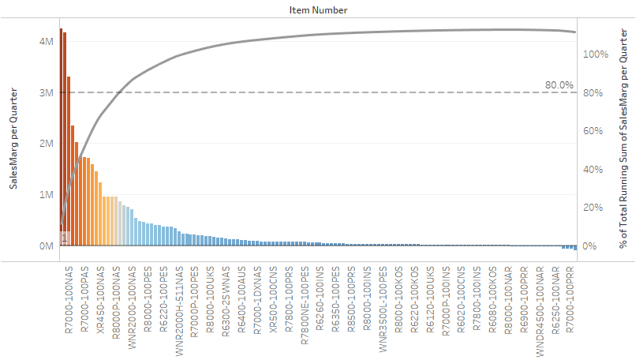

Slide 41
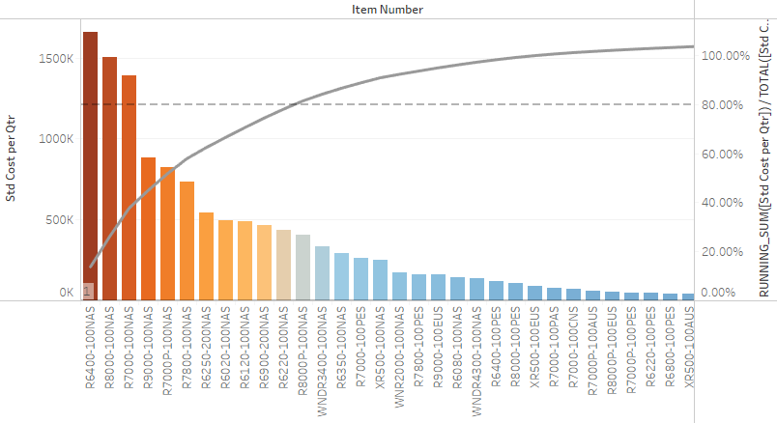

Slide 42
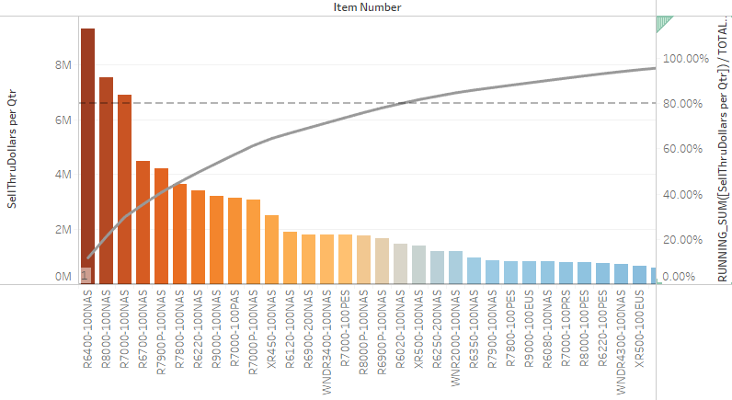

Slide 43
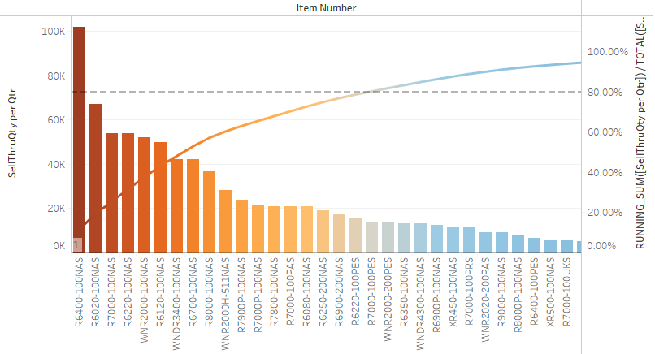

Slide 44
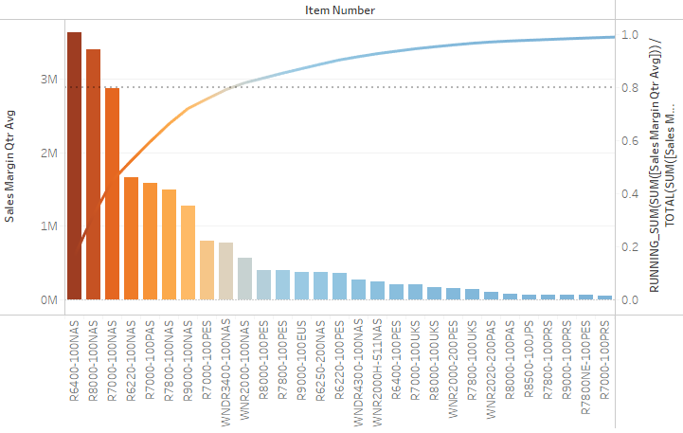
Routers Sales Margin Quarterly Average*

Slide 45
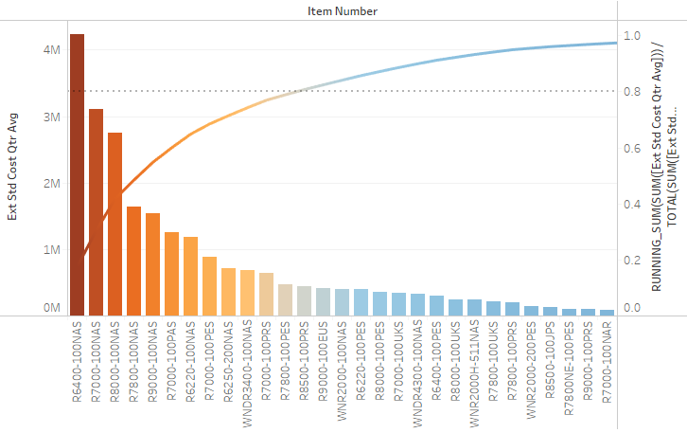
Routers Extended Standard Cost Quarterly Average*

Slide 46
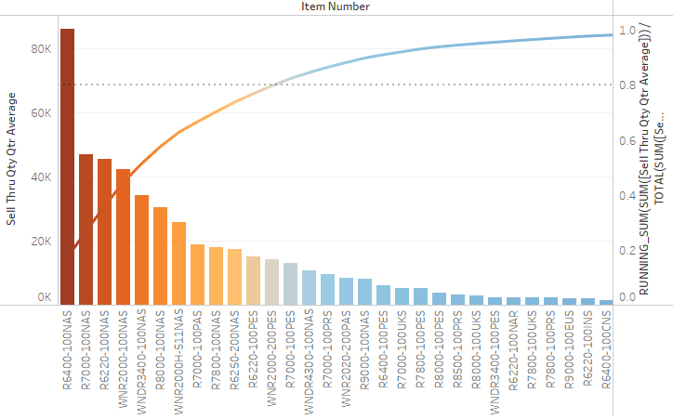
Routers Sell Thru Qty Quarterly Average*

Slide 47
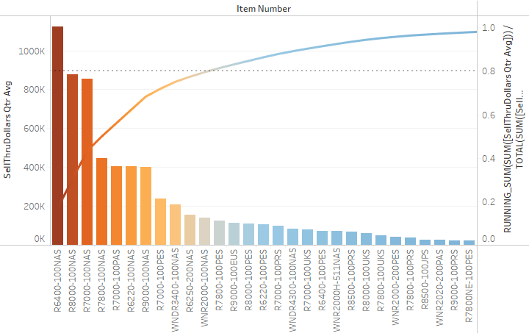
Routers Sell Thru Dollars Quarterly Average*

Slide 48
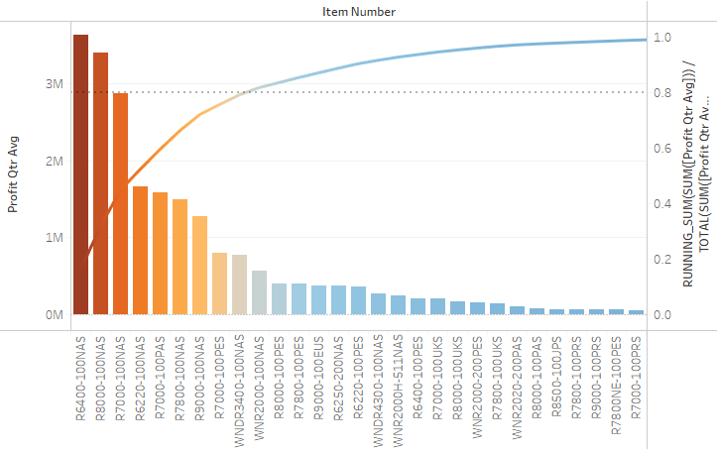
Routers Profit Quarterly Average*

Slide 49
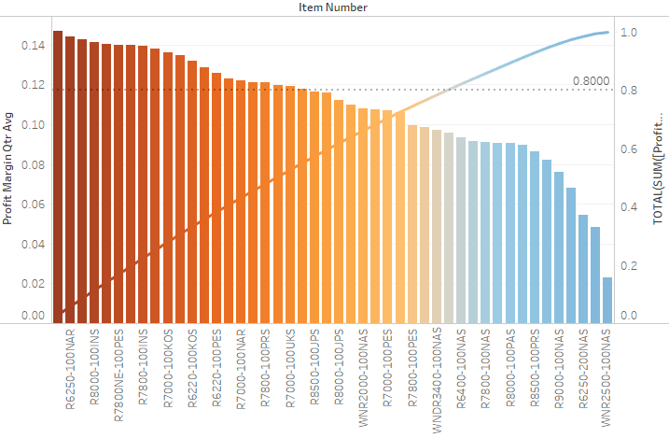
Routers Profit Margin Quarterly Average*

Slide 50
